Slide 1

Digital Portfolio
STUDENT NAME: MADHUMITHA BABU
REGISTER NO AND NMID:asunm111240111033021
DEPARTMENT: BCA/COMPUTER APPLICATION
COLLEGE:L N GOVERNMENT COLLEGE/ MADRAS UNIVERSITY

Slide 2

PROJECT TITLE
" Digital portfolio using front end web development"

Slide 3

AGENDA
Problem Statement
Project Overview
End Users
Tools and Technologies
Portfolio design and Layout
Features and Functionality
Results and Screenshots
Conclusion
Github Link

Slide 4

PROBLEM STATEMENT
Many students and professionals struggle to present their skills, projects, and achievements effectively.
Traditional resumes are static and text-heavy, failing to demonstrate technical skills or creativity.
A digital portfolio provides a dynamic and interactive way to showcase work and make a strong impression on potential employers.

Slide 5

PROJECT OVERVIEW
The project aims to create a personal digital portfolio website to: Showcase academic qualifications, projects, and achievements. Provide an interactive platform for recruiters to view skills and experience. Act as a central hub for links to LinkedIn, GitHub, and other profiles. Ensure easy navigation and mobile responsiveness.

Slide 6

WHO ARE THE END USERS?
Students and Fresh Graduates – to display their work for internships or job applications. Job Recruiters / HR Managers – to evaluate candidates' skills and projects. Freelancers – to present their portfolio to clients. Academics / Educators – to share research and achievements

Slide 7

TOOLS AND TECHNIQUES
Frontend: HTML5, CSS3, JavaScript Frameworks: Bootstrap / Tailwind CSS Backend (Optional): Python Flask / Django or Node.js Database (Optional): MySQL or MongoDB Design Tools: Figma, Canva Version Control: Git, GitHub Hosting: GitHub Pages / Netlify / Vercel

Slide 8

GitHub Link
https://madhu033021.github.io/Madhumitha/

Slide 9

FEATURES AND FUNCTIONALITY
Dynamic Project Showcase with detailed descriptions and live demos. Downloadable Resume in PDF format. Dark Mode / Light Mode Toggle (optional). Responsive Design for seamless viewing across devices. Contact Form Integration for direct communication. Live Hosting for easy accessibility.

Slide 10

POTFOLIO DESIGN AND LAYOUT
Sections: Home Page – Personal intro and tagline. About Me – Career background, education, and interests. Skills Section – Visual representation of technical and soft skills. Projects Page – Completed projects with screenshots and GitHub links. Certificates / Achievements – Academic and professional awards. Contact Page – Contact form and social links. Design Style: Clean, minimalist interface with professional color schemes. Responsive layout for desktop, tablet, and mobile. Easy and intuitive navigation.
10

Slide 11

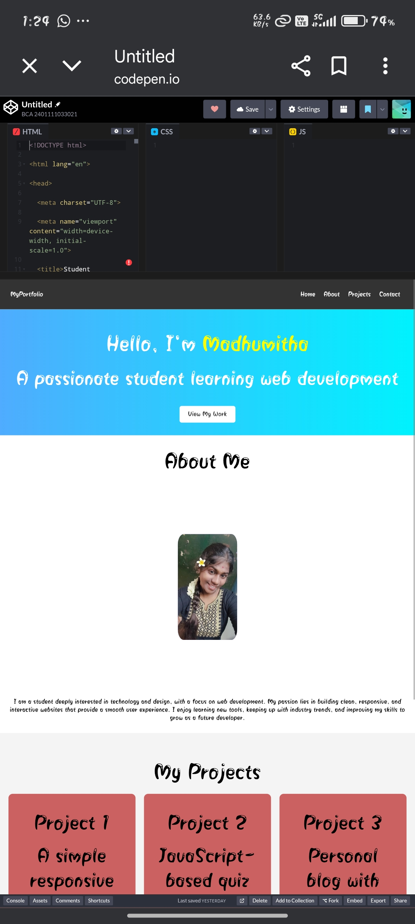
RESULTS AND SCREENSHOTS
Outcome of the Project: A fully functional digital portfolio hosted online. Improved professional presentation of skills and projects. Greater visibility for job opportunities and networking. Include screenshots of: Home Page Skills Section Project Showcase Contact Form
3/21/2024 Annual Review
11

Slide 12

CONCLUSION
The Digital Portfolio project provides: A modern professional identity in the digital space. A practical solution to overcome the limitations of traditional resumes. A platform to showcase technical skills, creativity, and growth. Long-term usability for career development and networking. “Your portfolio is your personal brand – let it speak
12

